Slide 1


PROBLEM SOLVING AND DECISION MAKING
USEEP - Training
Leadership and Management of Institutions
Theme 1 : Day 3

Slide 2
STUDY OBJECTIVES:
Participants to appreciate & be able to explain:
The of: concepts Problem, Problem-Solving, Decision, & Decision-Making
Key Stages & Steps in problem solving
Major types of decisions
Decision-making strategies
Barrers to decision making

Slide 3


Slide 4
Overview of Problem solving
One of a manager’s responsibilities is to solve problems.
Falling short of the ability to solve problems effectively can be a source of anxiety and stress for any school.
A school’s success depends on managerial problem-solvers.
Some problems are complex and detailed, some are relatively basic but with big implications if you get things wrong.

Slide 5
What is a problem?
A problem is an issue or obstacle which makes it difficult to achieve a desired goal, objective or purpose.
It refers to a situation, condition, or issue that is yet unresolved.
In a broad sense, a problem exists when there’s a significant difference between what actually is and what is desired.

Slide 6
Einstein is quoted as having said that if he had one hour to save the world, he would spend fifty-five minutes defining the problem and only five minutes finding the solution.
This quote illustrates an important point: Before jumping right into solving a problem, we should step back and invest time and effort to improve our understanding of it

Slide 7
Definition of problem solving
Every problem asks for an answer or a solution. Trying to find a solution to a problem is known as problem solving.
Problem solving is implementing processes that reduce or remove obstacles that are preventing you or others from accomplishing operational and strategic business goals.

Slide 8
What are the common problems in Schools?
Absence of clear direction
Difficulty blending multiple personalities into a cohesive and unified team.
Failure to develop key competencies and behaviors
Poor communication and feedback

Slide 9
GROUP work : PROBLEM SOLVING AND DECISION MAKING
1. What are the common problems in Schools?
2. What are the Sources of these problems?
3. How are decisions made to solve these problems ?
4. What Challenges do you face in decision making

Slide 10
More problems
Stakeholder conflict
Team weaknesses
Unrealistic timeframes and tasks
Competing priorities
Poor communication
Insufficient resources (funding and personnel)
School politics
Bad decisions
Internal conflicts

Slide 11
Sources of problems at place of work
Bosses
You the employee
Colleagues
External forces
Subordinates
Working environment

Slide 12
Problem Solving
Problem-solving works best when it is approached through a consistent system in which individuals:
Identify and define the problem
Prioritize the problem based on size, potential impact, and urgency
Complete a root-cause analysis
Develop a variety of possible solutions
Evaluate possible solutions and decide which is most effective
Plan, implement and monitor the solution

Slide 13
Decision and Decision making
A decision is an act of selection or choice of one action from several alternatives.
Decision making is the process of identifying and choosing alternative courses of action to solve a problem.
Decision-making can be defined as the process of selecting a right and effective course of action from two or more alternatives for the purpose of achieving a desired result.

Slide 14
When do we need decisions?
According to P. F. Drucker – “What­ever a manager does, he does through making decisions.”
All matters relating to planning, organising, direction, co-ordination and control are settled by the managers through decisions which are executed into practice
Objectives, goals, strate­gies, policies and organisational designs are all to be decided upon in order to regulate the performance of the business
The entire managerial process is based on decisions. Decisions are needed both for tackling the problems as well as for taking maximum advantages of the opportunities available.

Slide 15
Implications of decision making
Making decisions, means exercising choice. You decide what to do on the basis of some conscious and deliberate logic or judgement.
When making a decision the managers are faced with alternatives. An organisation does not take a wise manager to reach a decision when there are no other possible choices. It does require wisdom and experience to evaluate several alternatives and select the best one.
When taking a decision, the managers have a purpose. They propose and analyse the alternative courses of action and finally make a choice that is likely to move the organisation in the direction of its goals.

Slide 16
Types of Decisions
Selection decisions/Pre-determined (Making a choice from already programmed or routine decisions)
Creative decisions/non-routine (Invented alternatives and then the best choice is selected – test of the capability of a manager)

Slide 17
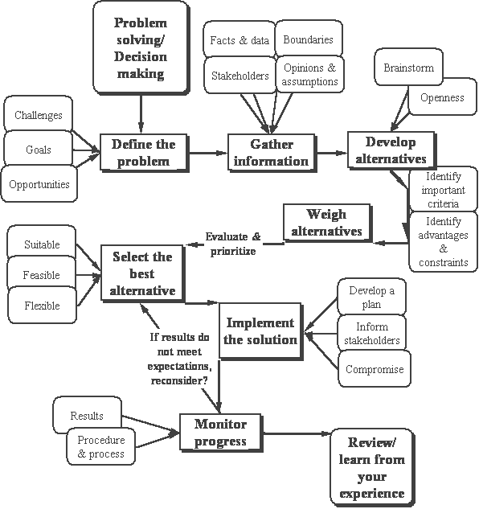

Slide 18
Principles of decision making (Adopted from Priyali Sharma)
Subject-matter of Decision-making
Decisional matters or problems may be divided into groups consisting of programmed and non-programmed problems.
Organisational Structure
If the organisational structure is rigid and highly centralised, decision-making authority will remain confined to the top management level. This may result in delayed and confused decision and create suspicion among the employees.
Analysis of the Objectives and Policies
Without this analysis, decision-making will be aimless and unproductive

Slide 19
Principles of decision making cont’d
Analytical Study of the Alternatives
Analytical study of all possible alternatives of a problem with their merits and demerits is essential. This is necessary to make out a correct selection of decision from among the alternatives.
Proper Communication System
Ignorance of decision or ill-informed decision will result in misunderstanding and loose co-ordination
Sufficient Time
Effective decision-making requires sufficient time.
Study of the Impact of a Decision
A decision in any particular area may react adversely in other areas of the organisation. A study and analysis of the impact of any decision should precede its application.

Slide 20
Principles of decision making cont’d
Participation of the Decision-maker
The principle of participation in work of the decision-maker will enable him/her to understand whether the decision taken is practical and also guide in forthcoming decisional matters.
Flexibility of Mind
Decisions cannot satisfy everybody. Rigid mental set-up of the decision-maker may upset the decisions. The flexible mental disposition of the decision-maker enables him/her to change the decision and win over the co-operation of all the diverse groups

Slide 21
Challenges in decision making
Indecisiveness – Timidity
Postponing the decision until the last moment – eliminating possibility of thorough analysis of the problem which is considered time consuming
Failure to isolate the root cause of the problem
The failure to assess the reliability of informational sources – taking it for granted that other person’s opinion is very reliable and trustworthy and fail to check for accuracy
The method for analysing the information may not be the appropriate one
Failure to implement the decision – making a decision is not the end of the process rather it is the beginning

Slide 22
Non-Decision Makers
Procrastinators (Keep postponing)
Vacillators (Think problems keep rotating and passing)
Fence Sitters (Sit and watch as problems occur)
Pipe smokers(Think problems disappear as smoke)
Professors (Want to 1st do research and read volumes of books to see how others did it)

Slide 23
END
THANK YOU

